Slide 1


CS310
Course Project
MentOS
Anubhab Chakraborty
Pranav Tambe
Umar Sayed
Akhil Thirukonda Sivakumar

Slide 2

What is MentOS?
MentOS (Mentoring Operating System) is an open source educational operating system.
The goal of MentOS is to provide a project environment that is realistic enough to show how a real operating system works
Original creator:
Enrico Fraccaroli, and others
Pre-Implemented features
Processes and Events
Memory
Filesystem
Input/Output

Slide 3

Scheduling Algorithms
Round-Robin(RR)
Highest priority
Completely Fair Scheduling (CFS)
Improvements Made
Deadlock Avoidance
Banker’s Algorithm

Slide 4
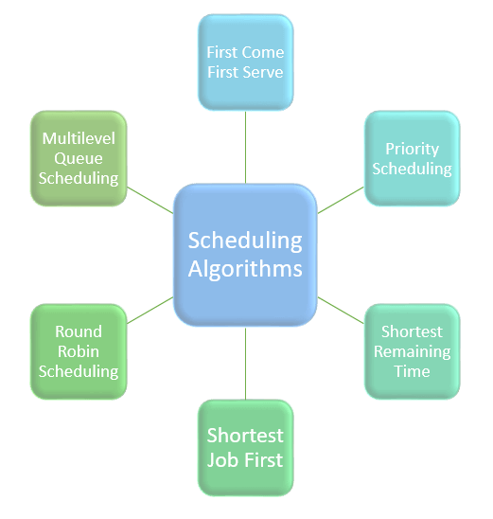
SCHEDULING ALGORITHMS
A scheduling algorithm is a method for arranging tasks or processes on system resources, such as the CPU, to enhance resource use, boost system performance, and ensure equitable access for various processes.

Slide 5

Round Robin
Priority Scheduling
Algorithms Implemented
Completely Fair Scheduling

Slide 6
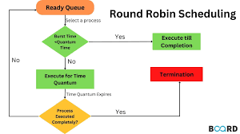
Round Robin
Round Robin is a CPU scheduling algorithm where a fixed time slice is assigned to each system process, in a cyclic way. It is simple, preemptive, easy to implement, and starvation-free.

Slide 7
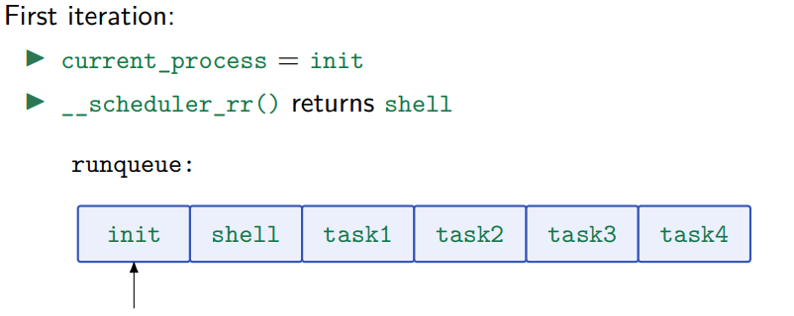
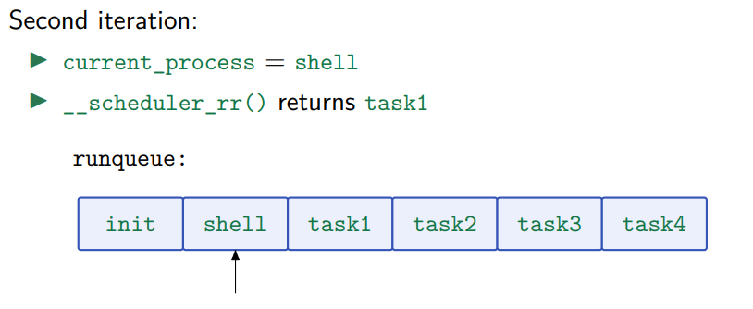
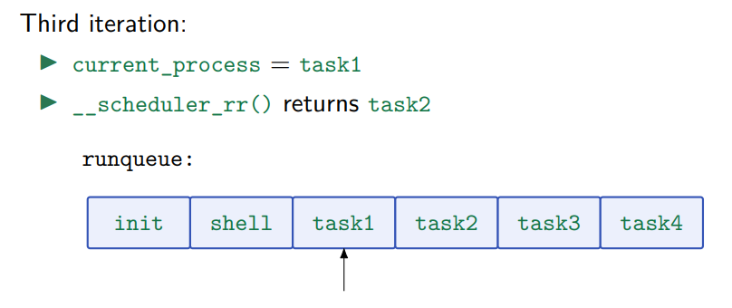
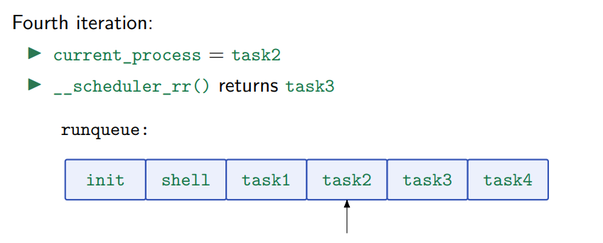
Round Robin
Pictorial Example

Slide 8
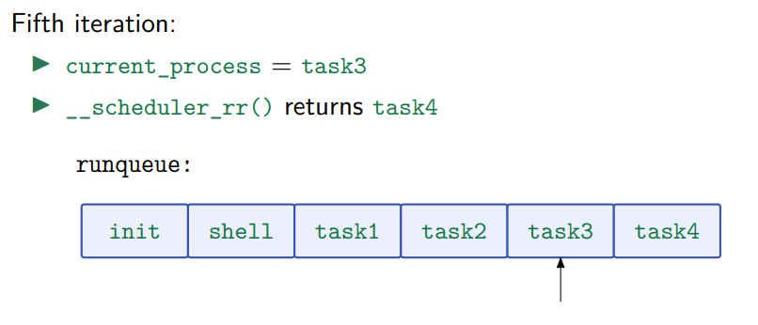
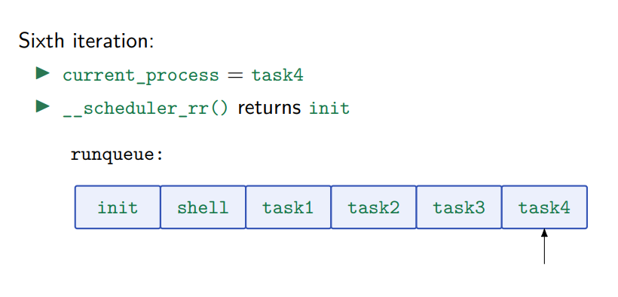

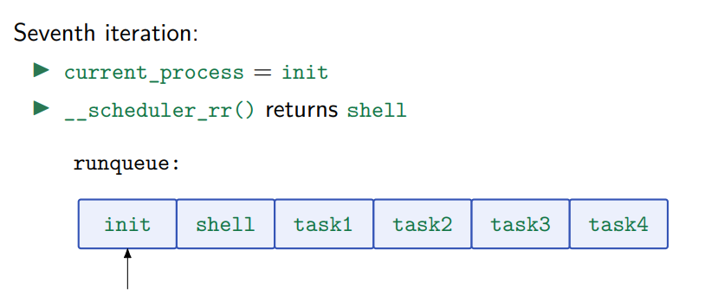
Round Robin
Pictorial Example continued...

Slide 9



Slide 10
Priority Scheduling
Priority scheduling assigns a priority to each process.
Priority factors can include memory and time requirements, system-defined priority, and importance.
Lower numerical values may indicate higher priorities (system-dependent).
The scheduler picks the highest-priority process for execution.
In cases of multiple processes with the same highest priority:
First-come-first-serve or
Round-robin scheduling principles may be applied.

Slide 11
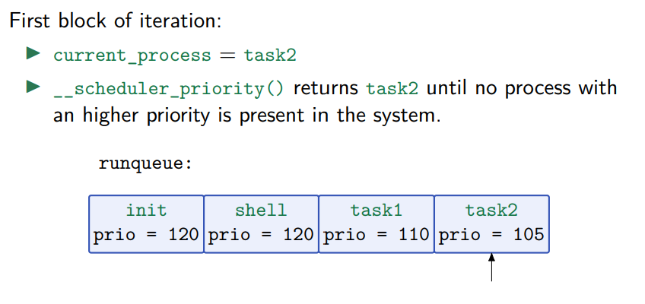
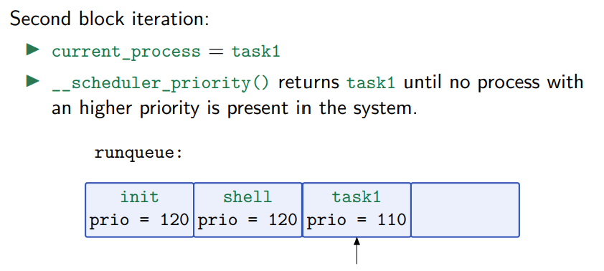
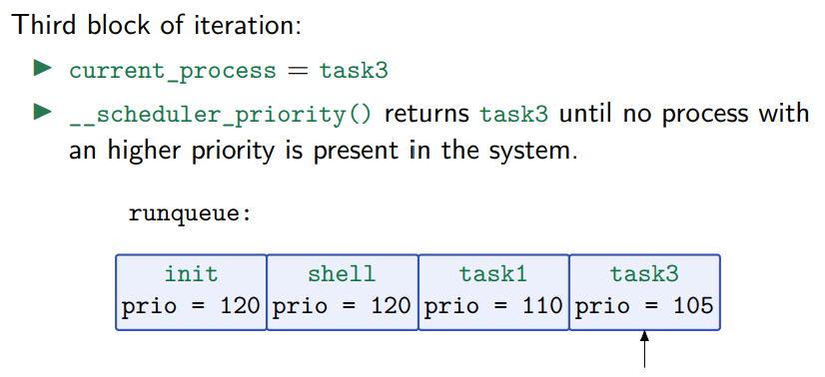
Priority Scheduling
Pictorial Example

Slide 12
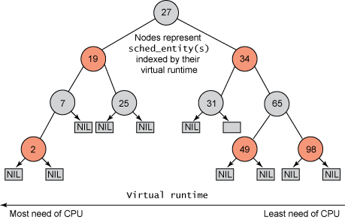
Completely Fair Scheduler(CFS)
Completely Fair Scheduler aims to prevent starvation by assigning CPU to all processes in a fair manner. The idea of CFS process is that every process has its own virtual time. If a process has run for t seconds then its virtual time is incremented by t seconds. So, whenever context switch occurs it ways chooses process with minimum virtual time for execution.

Slide 13


Deadlock
A deadlock is a situation in which two or more processes are blocked, waiting for each other to release a resource. This can happen when two processes are both holding a resource that the other process needs.

Slide 14

Necessary Conditions for a Deadlock
Mutual Exclusion
Hold and wait
No preemption
Circular Wait
Ways to Handle Deadlocks
Deadlock prevention
Deadlock avoidance
Deadlock detection and recovery
Deadlock ignorance

Slide 15

Safe State
A state is safe if the system can allocate all resources requested by all processes ( up to their stated maximums ) without entering a deadlock state.
Safe State -> No Deadlocks
Unsafe State -> Possibility of Deadlock
Deadlock Avoidance -> Ensures that system will never Enter an Unsafe State

Slide 16

Multiple instance resource type
Banker’s Algorithm
Avoidance Algorithms
Single instance resource type
Resource Allocation Graph(RAG)

Slide 17
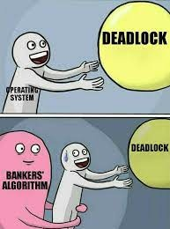
Banker’s Algorithm
The banker’s algorithm is a resource allocation and deadlock avoidance algorithm that tests for safety by simulating the allocation for the predetermined maximum possible amounts of all resources, then makes an “s-state” check to test for possible activities, before deciding whether allocation should be allowed to continue.

Slide 18
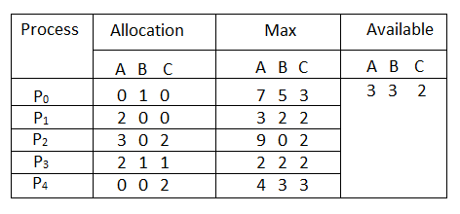
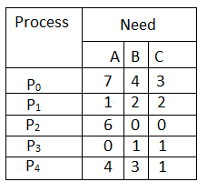
Banker’s Algorithm
Walkthrough
Process statistics
Need = Max - Allocated

Slide 19
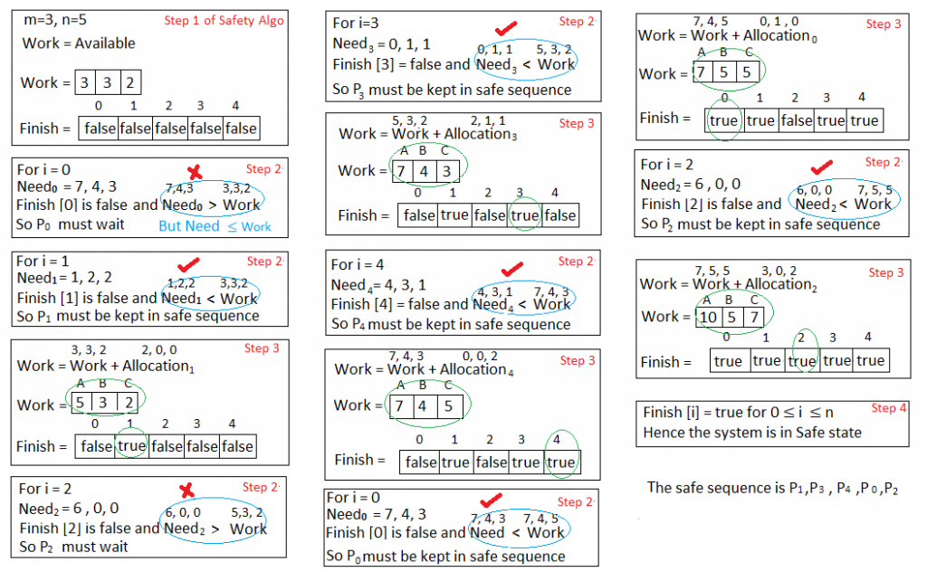

Banker’s Algorithm
Walkthrough

Slide 20
Banker’s Algorithm
Walkthrough

Slide 21

Banker’s Algorithm
Walkthrough

Slide 22
Conclusion
In the MentOS framework we implemented two scheduling algorithms namely - Priority Scheduling and CFS for smooth scheduling of all the processes running in the OS. The CFS algorithm is the default scheduling algorithm in Linux distribution since version 2.6.2
The OS originally had only a deadlock ignorance system, which we changed to deadlock avoidance by implementing the banker's algorithm. Ignoring deadlock in operating systems can lead to severe consequences such as system crashes, lost productivity, and decreased user satisfaction. Despite the tradeoff of slightly slowing the system, the decision to prioritize avoiding deadlock was rational, considering the benefits of averting system crashes and avoiding the need to reboot the system frequently.

Slide 23

References
https://github.com/mentos-team/MentOS
https://www.geeksforgeeks.org/deadlock-avoidance-in-distributed-system/
https://www.cs.uic.edu/~jbell/CourseNotes/OperatingSystems/7_Deadlocks.html#:~:text=1%20Safe%20State,without%20entering%20a%20deadlock%20state.

Slide 24
Thank you.

Slide 25






























Free Resources
Use these free recolorable icons and illustrations in your Canva design

